Slide 1
Bibliometric Analysis on Digital Learning

Slide 2
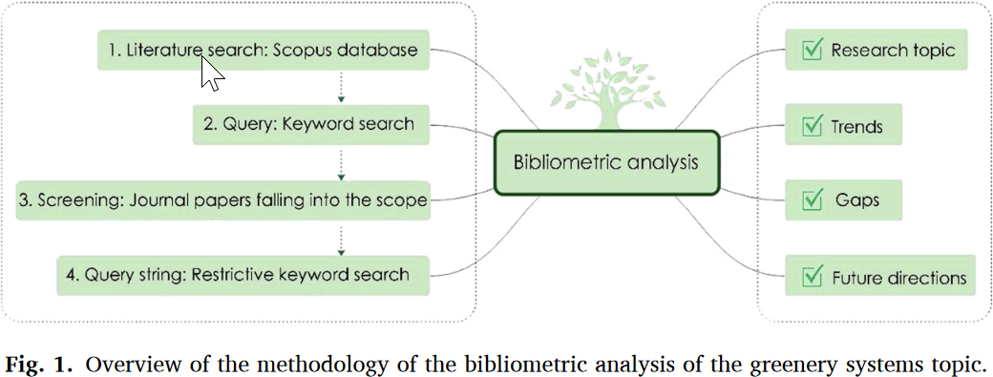
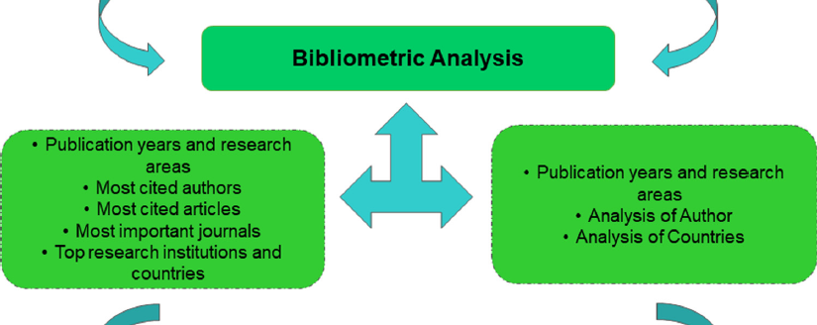
Bibliometric Analysis
https://www.sciencedirect.com/science/article/pii/S2210670720308258
https://www.sciencedirect.com/science/article/pii/S1359511321002178

Slide 3
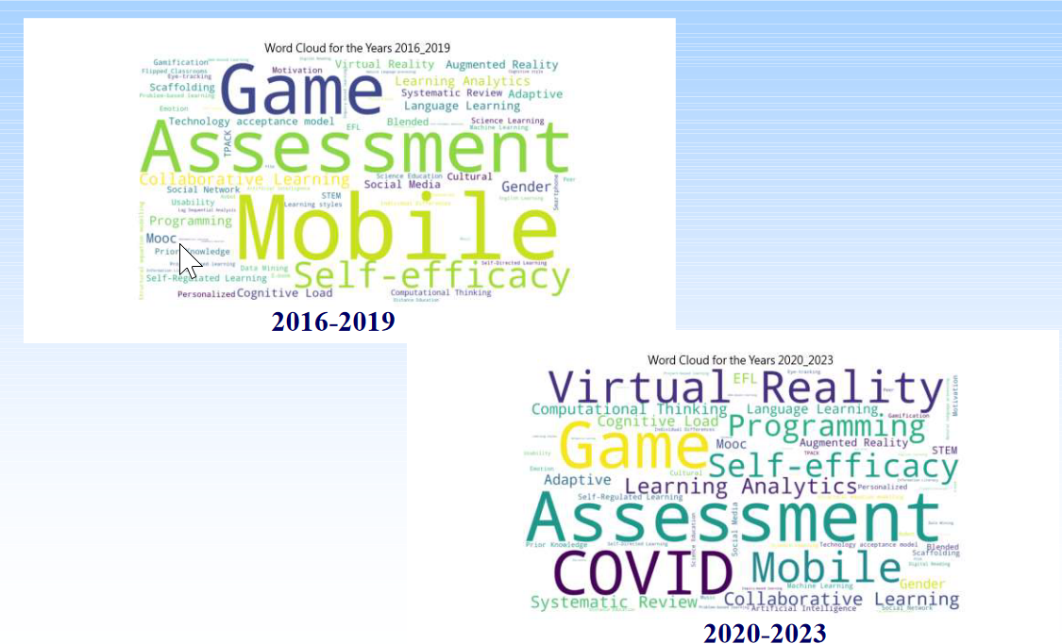
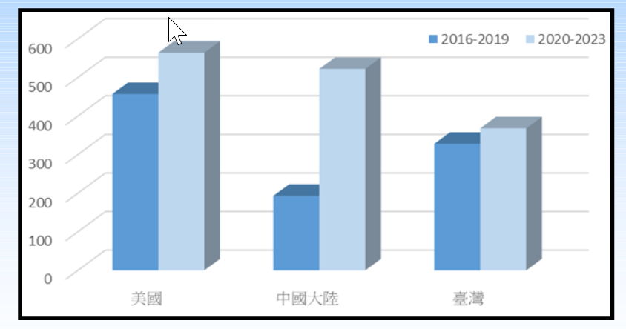
Changes between pre- vs. post- COVID Chen & Chen (2024)
Global
Cross countries
Changes in top TF-IDF topics
Changes in number of publications
Changes in top TF-IDF topics per country

Slide 4
Table of Top TF-IDF Keywords in Different Periods
Countries | 2016-2019 | 2020-2024
USA | Assessment, Game, Mobile, Scaffolding, Moocs, Collaborative learning, STEM | Game, Assessment, COVID, Learning analytics, Mobile, Adaptive, STEM
Taiwan | Mobile, Game, Self-efficacy, Language learning, | Game, Self-efficacy, Virtual reality, Mobile,
China | Mobile, Collaborative learning, Assessment, Self-efficacy, Virtual reality | Mobile, Self-efficacy, Assessment, COVID, Virtual Reality
Korea | Cognitive Load, Self-Regulated Learning, Smartphone, Digital Games, Mobile Learning | Scaffolding, COVID, Self-efficacy, Virtual Reality, EFL
Netherlands | Digital Games, Online Assessment, Moocs, Self-efficacy, Adaptive Learning | Digital Games, Online Assessment, Moocs, Self-efficacy, Self-Regulated Learning
Keywords are ordered based on frequencies within each country, respectively.
(Visually estimated from the word cloud. Should revise based on the actual frequency)

Slide 5
Suggestions
Statistical validation of the findings
Analysis on the time X country X keyword effect on the dependent variable
Increase the time resolution
Pre- vs. post- COVID → 2016, 2017, 2018, …, 2023
Geographic mapping of the dependent variables
Network analysis on the collaboration pattern
Evaluating between-country similarity in the hyperdimensional space
Representing each country as a vector of keywords, with the dependent variable as the magnitude
Compute the distance between countries in the hyperspace
Compare the similarity of country distances pre- vs. post COVID or changes of this pattern annually

Slide 6
Statistical Validation (Chi-squares?)
time  country  keyword effect
Main effects:
Time: Is there significant difference in TF-IDF between pre- vs. post- COVID?
Country: Is there significant difference among countries?
Keyword: Is there significant difference among keywords?
Interaction:
time  country: The way TF-IDF differ between countries differ between time
time  keyword: The way TF-IDF differ between keyword differ between time
keyword  country: The way TF-IDF differ between keyword differ between countries
Time  country  keyword: The country  time pattern differ between times

Slide 7
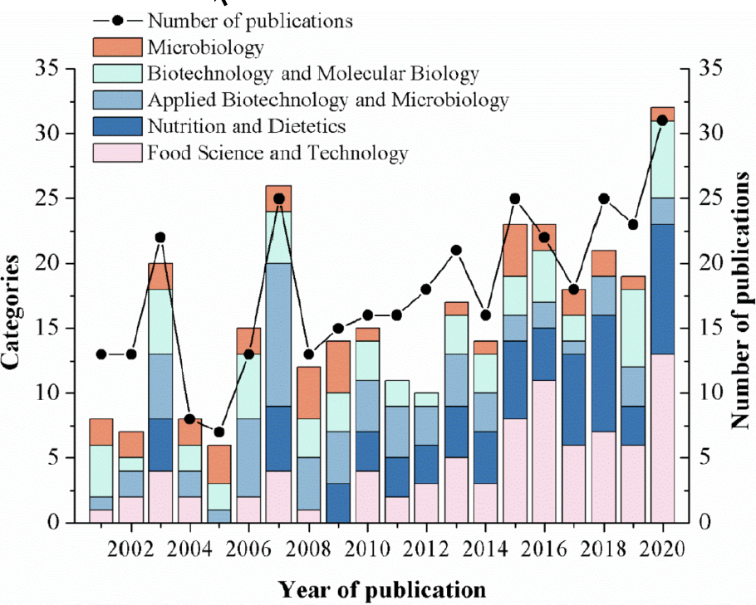
Time Resolution of the Analysis
Period Pattern
Annual Pattern

Slide 8
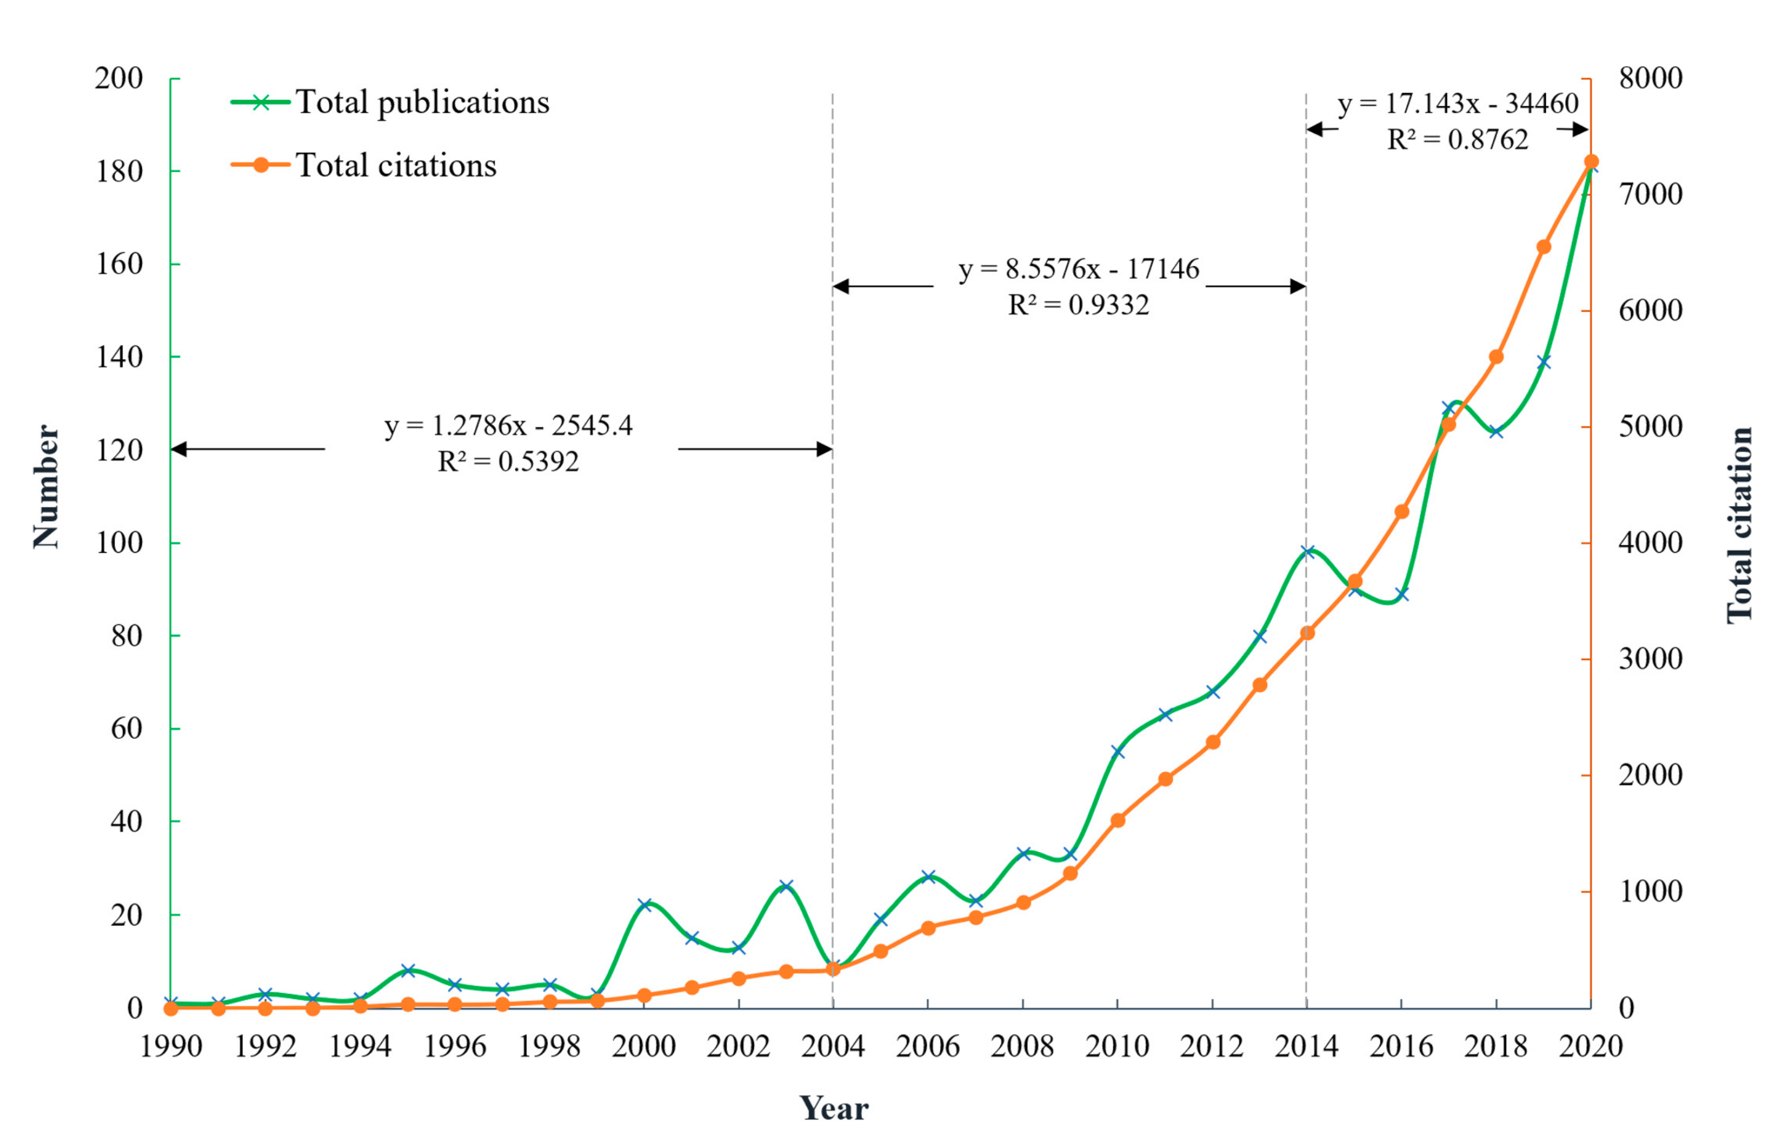
Growth Speeds of Publications & Citations in Different Time Periods

Slide 9
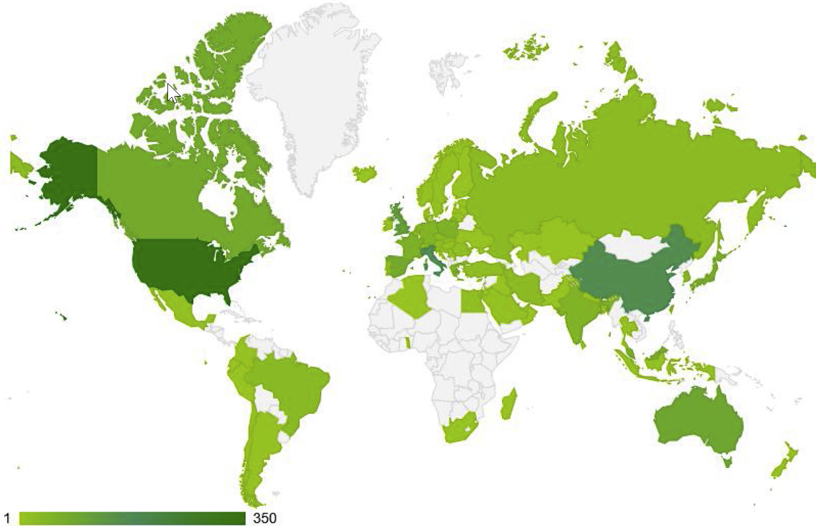
Example of Geographic Mapping
https://www.sciencedirect.com/science/article/pii/S2210670720308258

Slide 10
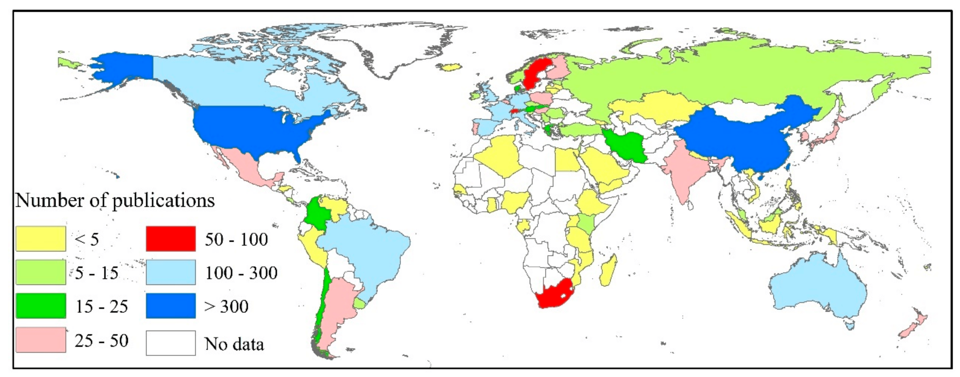
Example of Geographical Mapping

Slide 11
Network Analysis
Pattern of collaborations among countries, research teams, or authors
And the change of the pattern between periods
Patterns of relationship between keywords

Slide 12
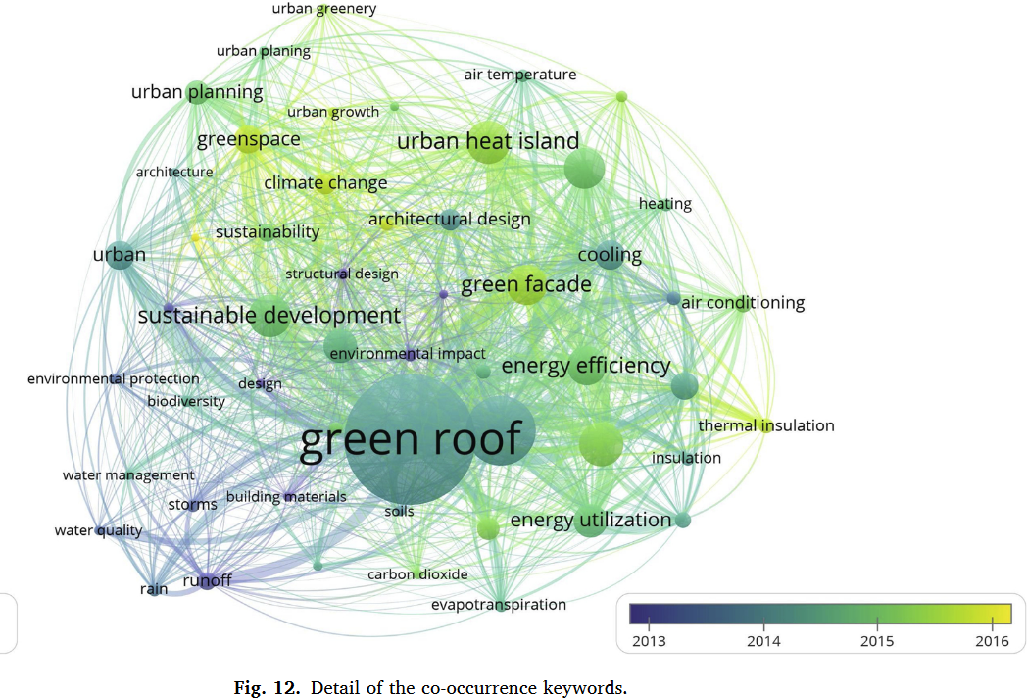
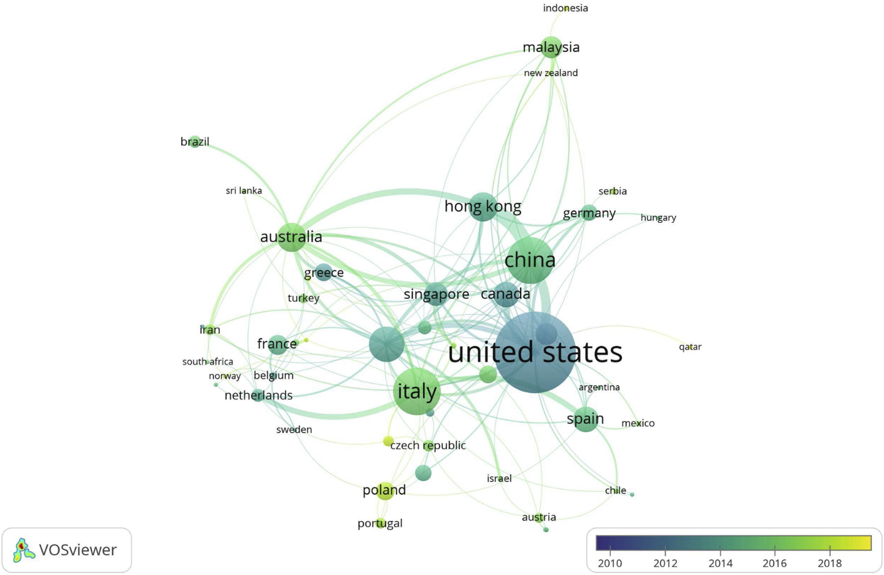
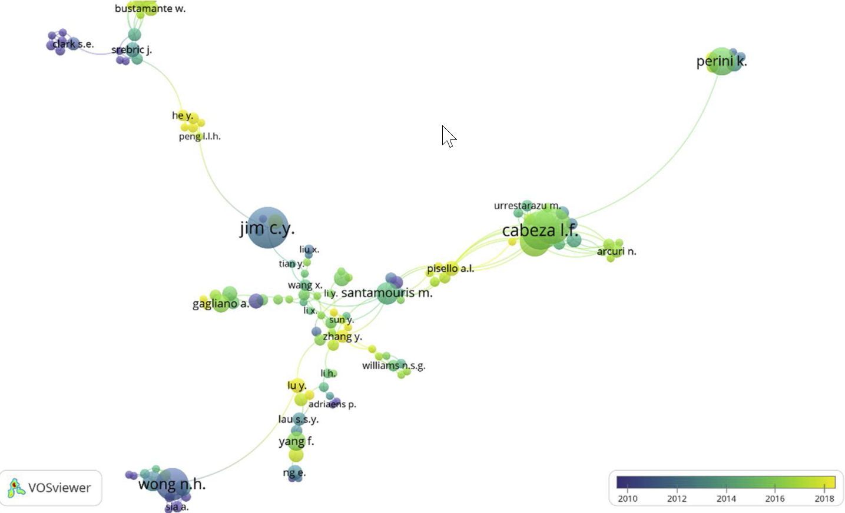
Network Analysis: Keywords, Countries, or Authors
keywords
Countries
Authors
https://www.sciencedirect.com/science/article/pii/S2210670720308258

Slide 13
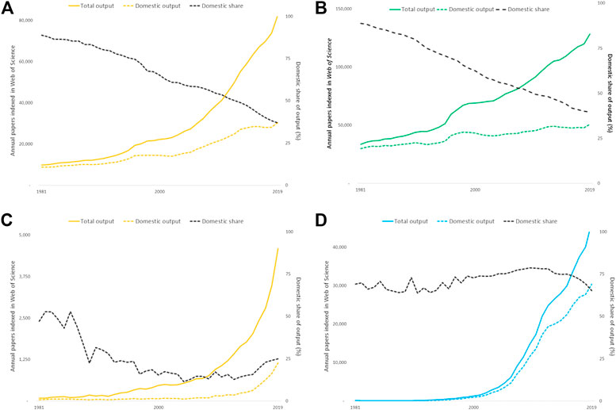
Trends in International vs. Domestic Research
Large research economies (Australia and Germany:
Almost all increase in annual publication counts can be accounted for by output shared with one or more collaborating countries whereas the domestic research output (with no international co-authors) has plateaued.
Smaller research economies (Indonesia & Iran):
risen more steeply but the profile of international collaboration is less consistent.
https://www.frontiersin.org/articles/10.3389/frma.2020.628703/full

Slide 14
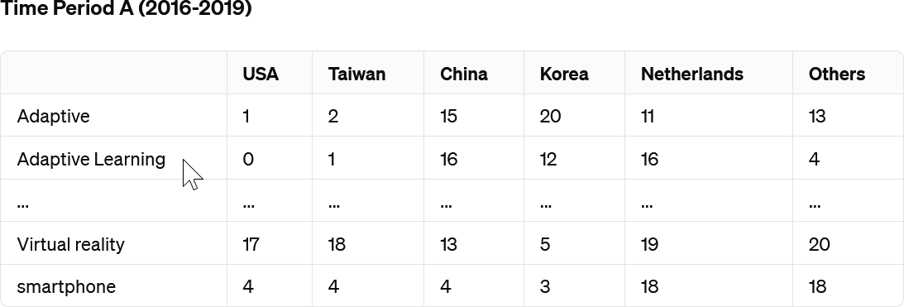
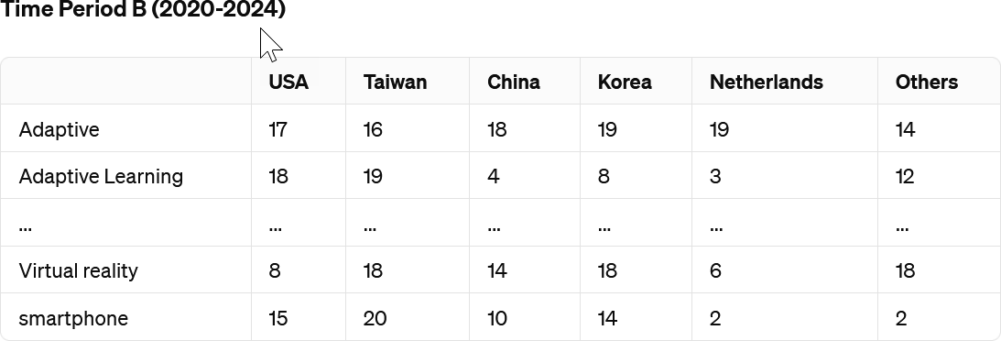
Similarity Analysis
Keyword ranking per country

Slide 15
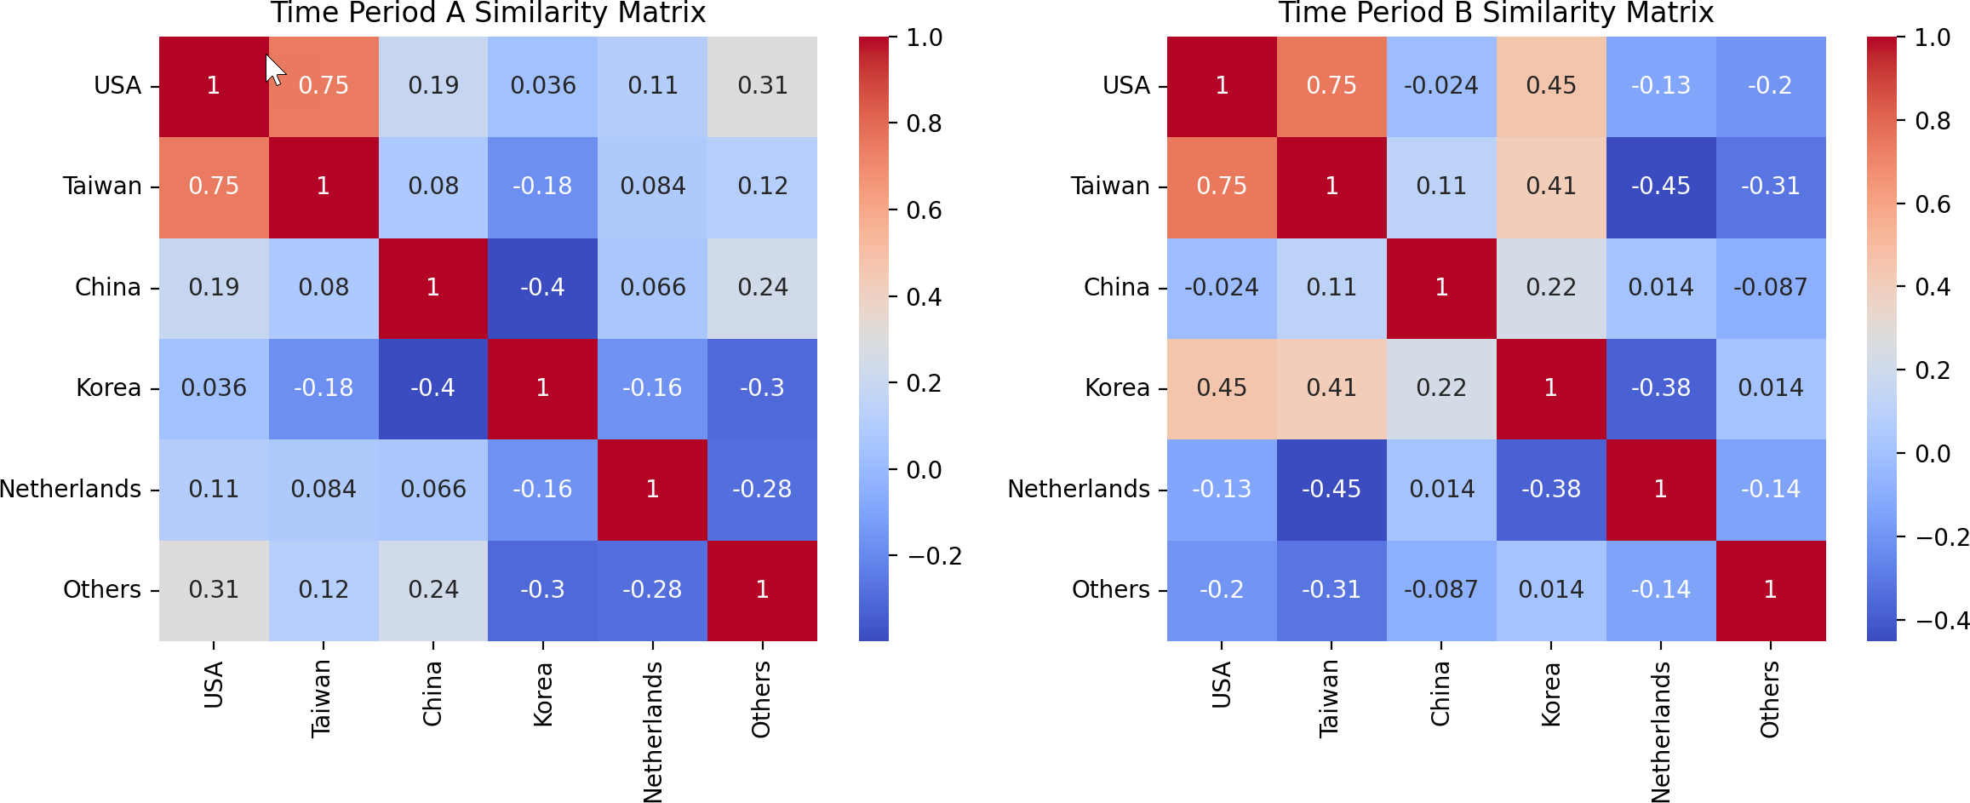
Correlation among Countries in Two Time Periods

Slide 16
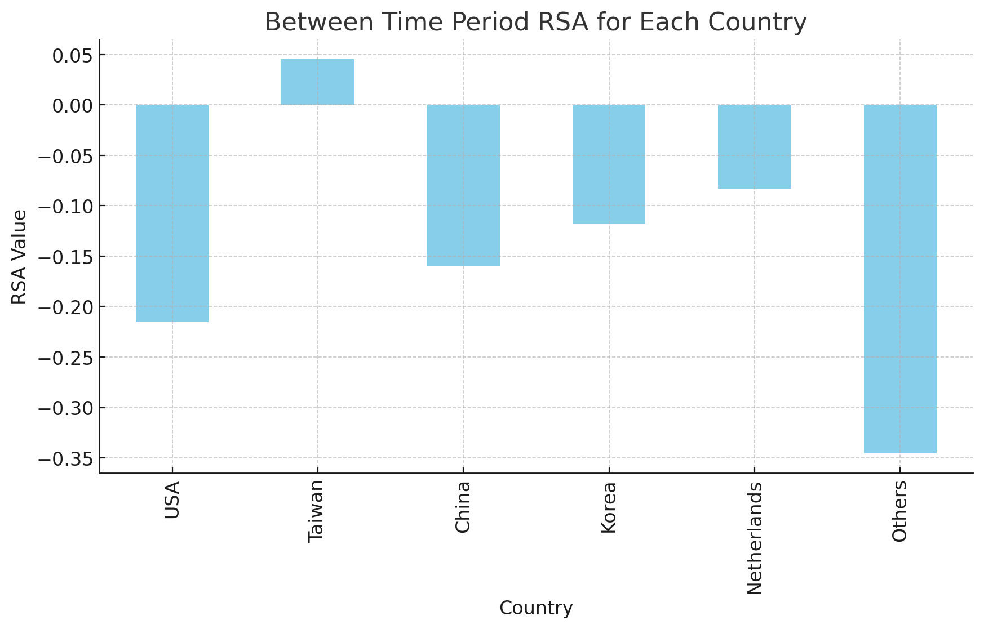
Similarity between Time Periods in Each Country

Slide 17
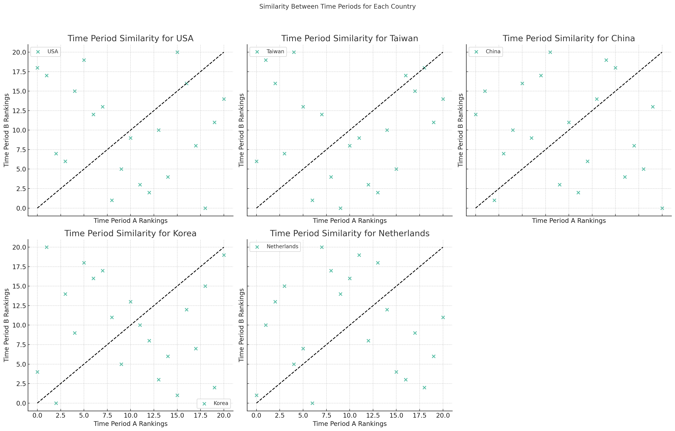
Scatter plots per Country for Rankings in Different Time Periods
Notes:
The scatter plots above illustrate the similarity between Time Period A (2016-2019) and Time Period B (2020-2024) for each country, using the rankings of keywords. Each point represents a keyword's rank in Time Period A plotted against its rank in Time Period B.
Points that lie on or near the diagonal line indicate that the keyword's rank remained relatively unchanged between the two time periods, suggesting a stable interest in that topic. Points that are further from the diagonal line indicate a change in rank, suggesting a shift in interest or relevance of that topic.

Slide 18
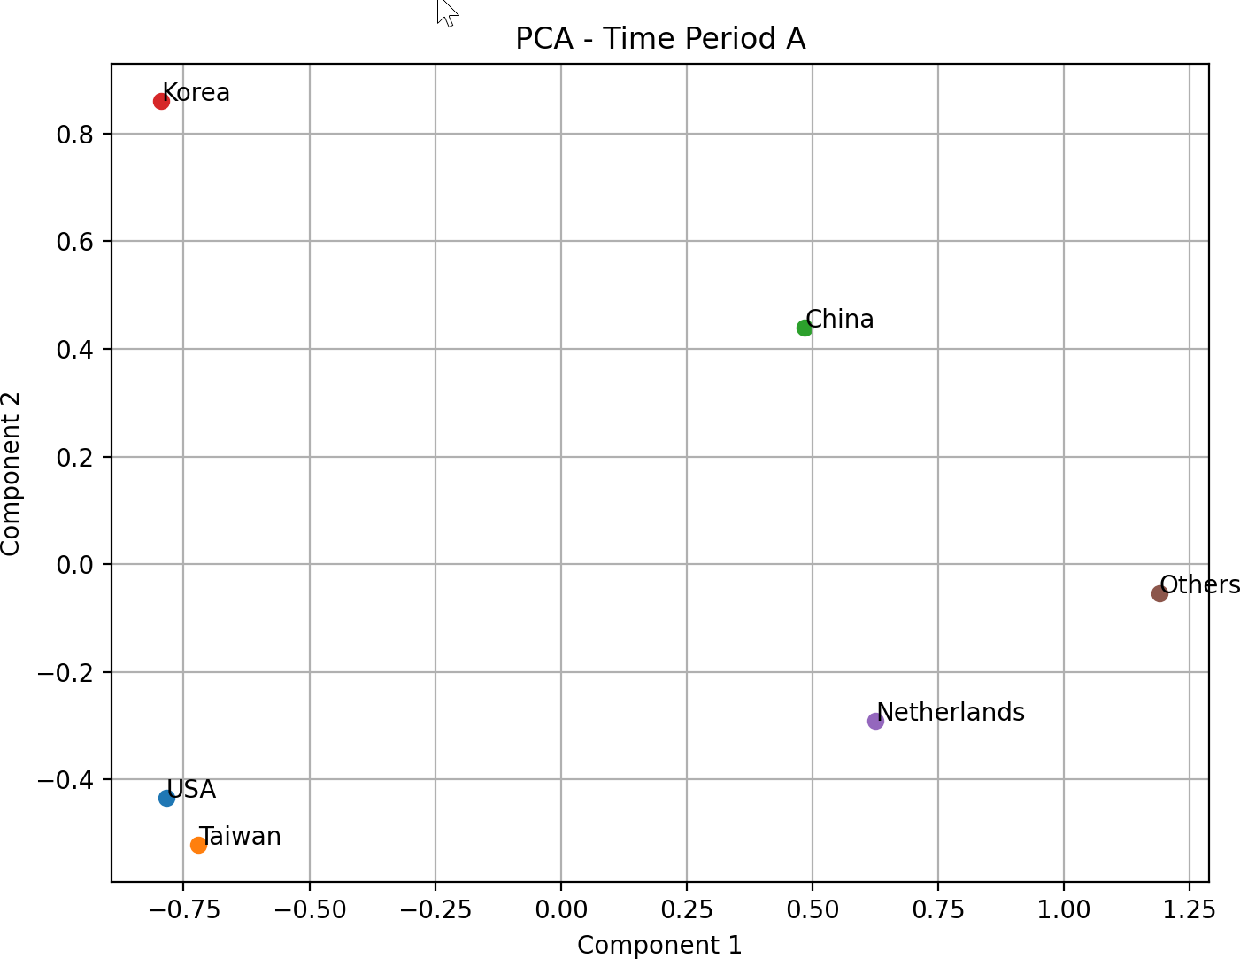
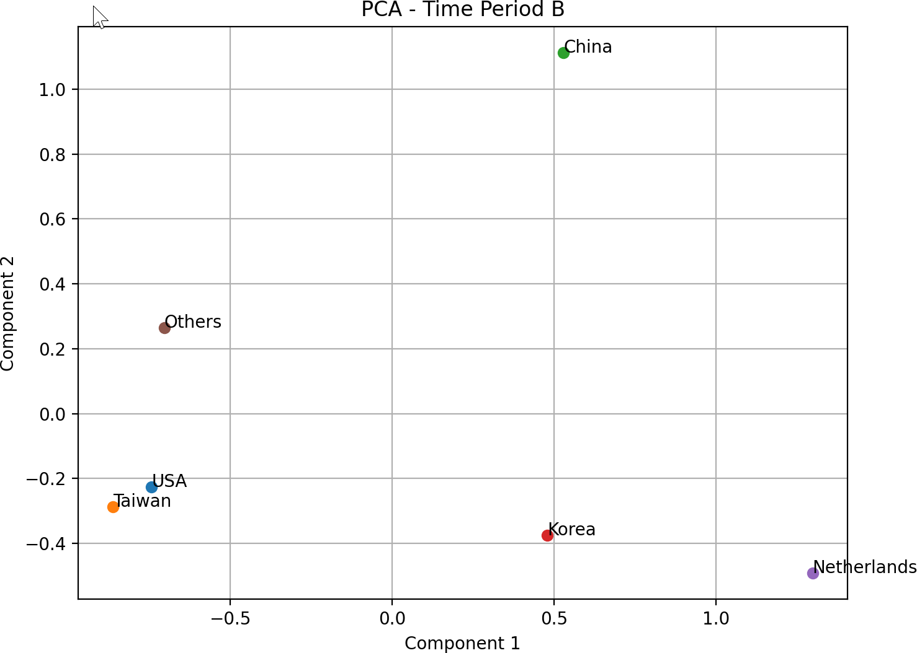
Dimension Reduction: PCA

Slide 19
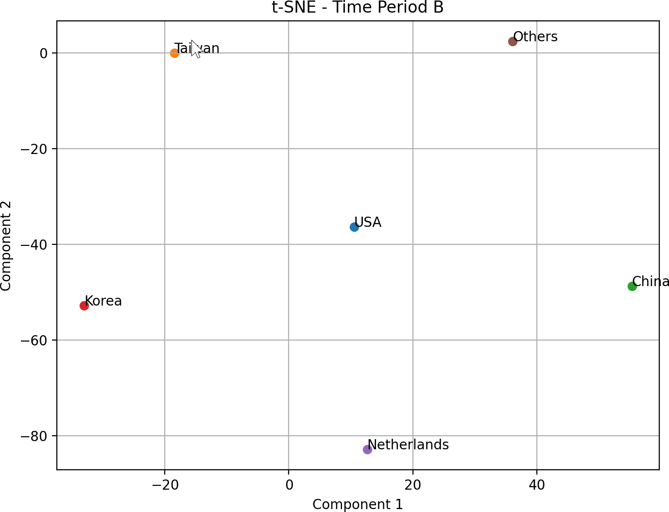
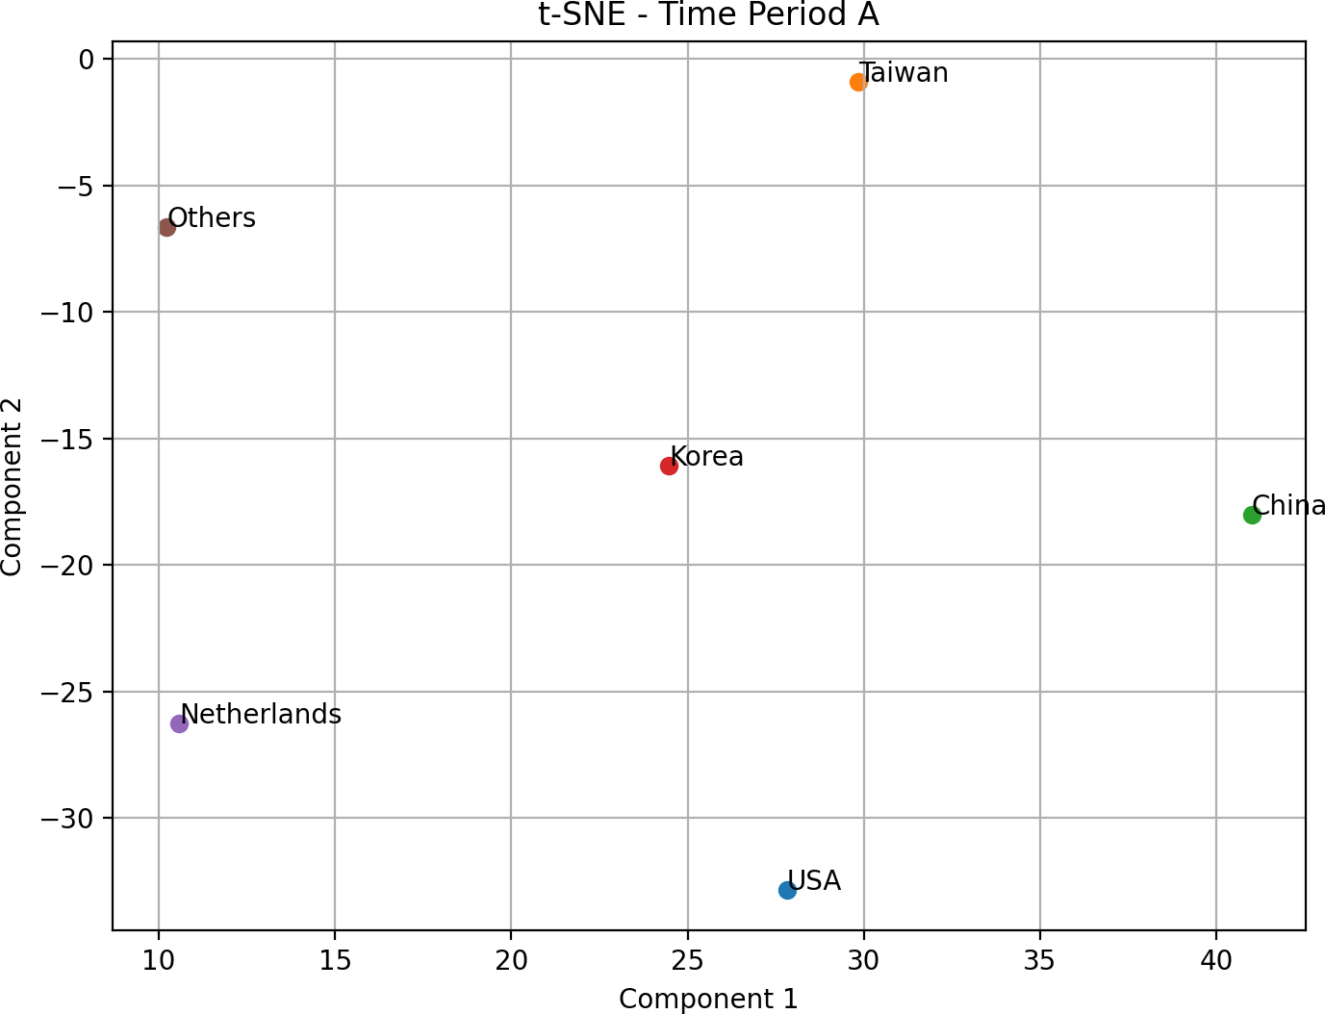
Dimension Reduction: tSNE

Slide 20
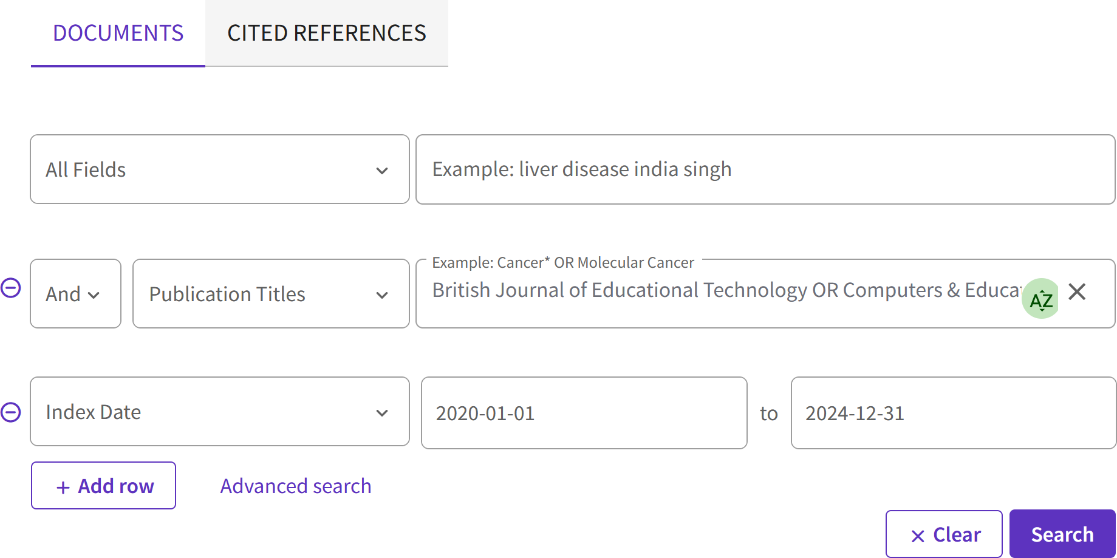
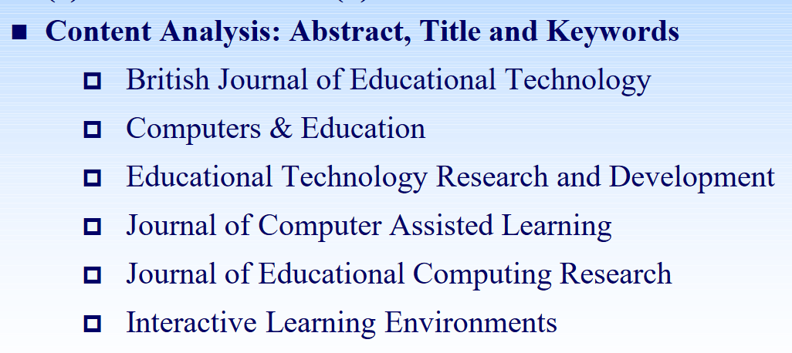
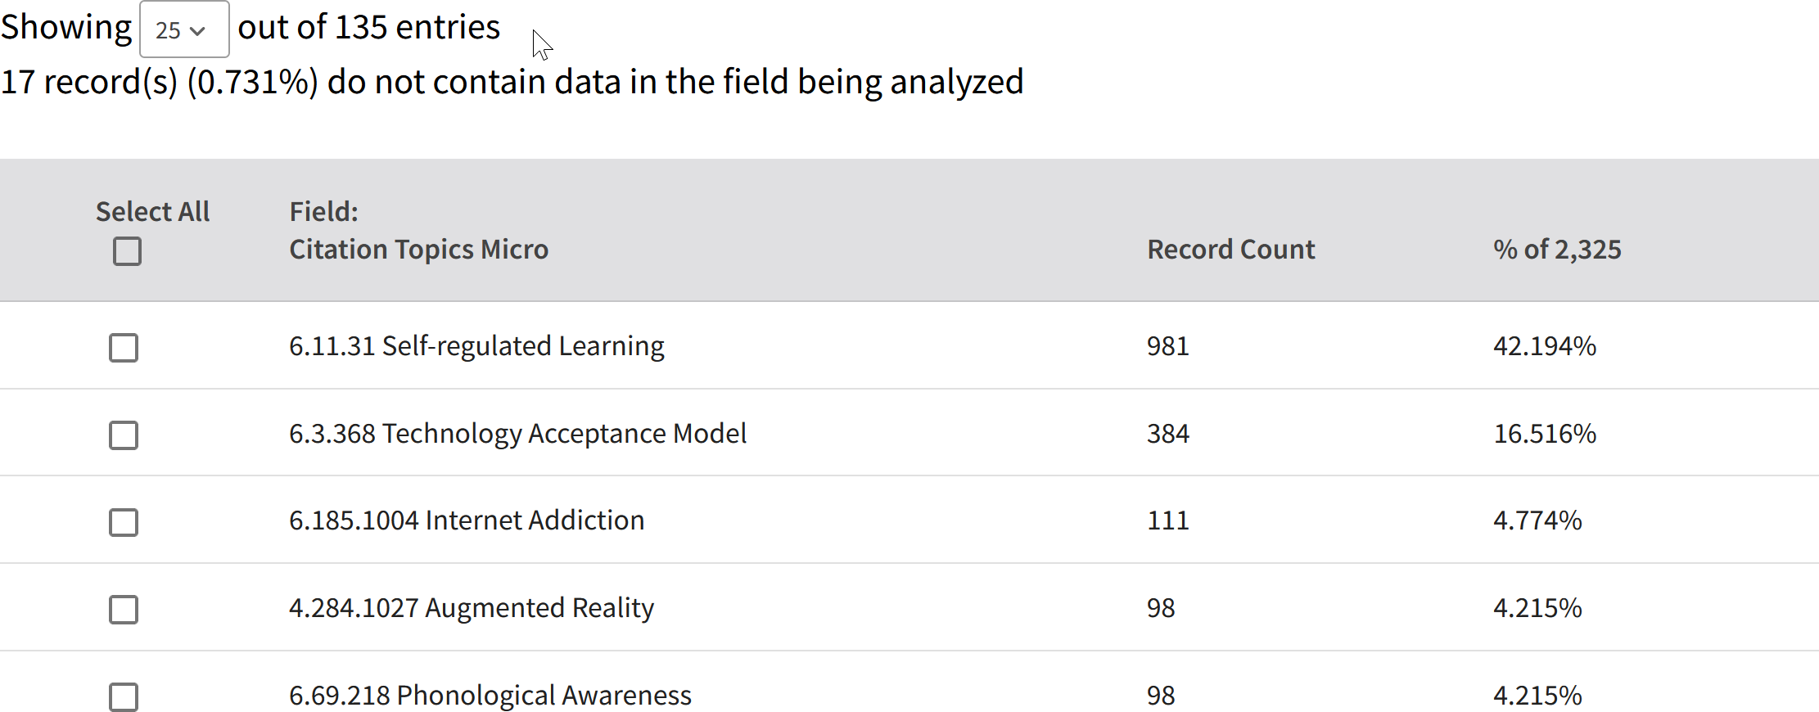
Cross-validation by Checking WoS Search on Publications in Journal of Interest
https://www.webofscience.com/wos/woscc/basic-search

Slide 21
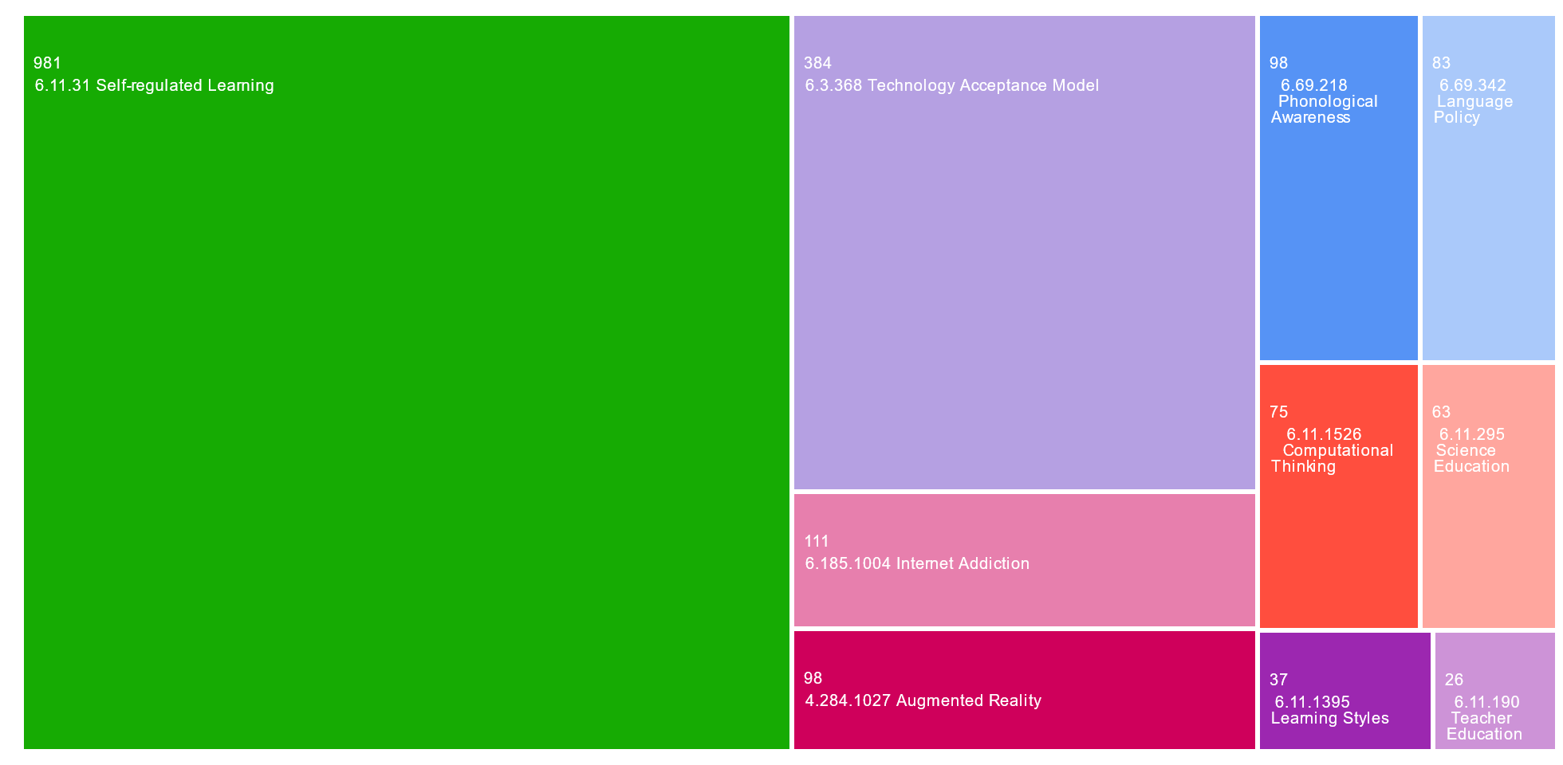
2016-2019 (2325 publications)

Slide 22
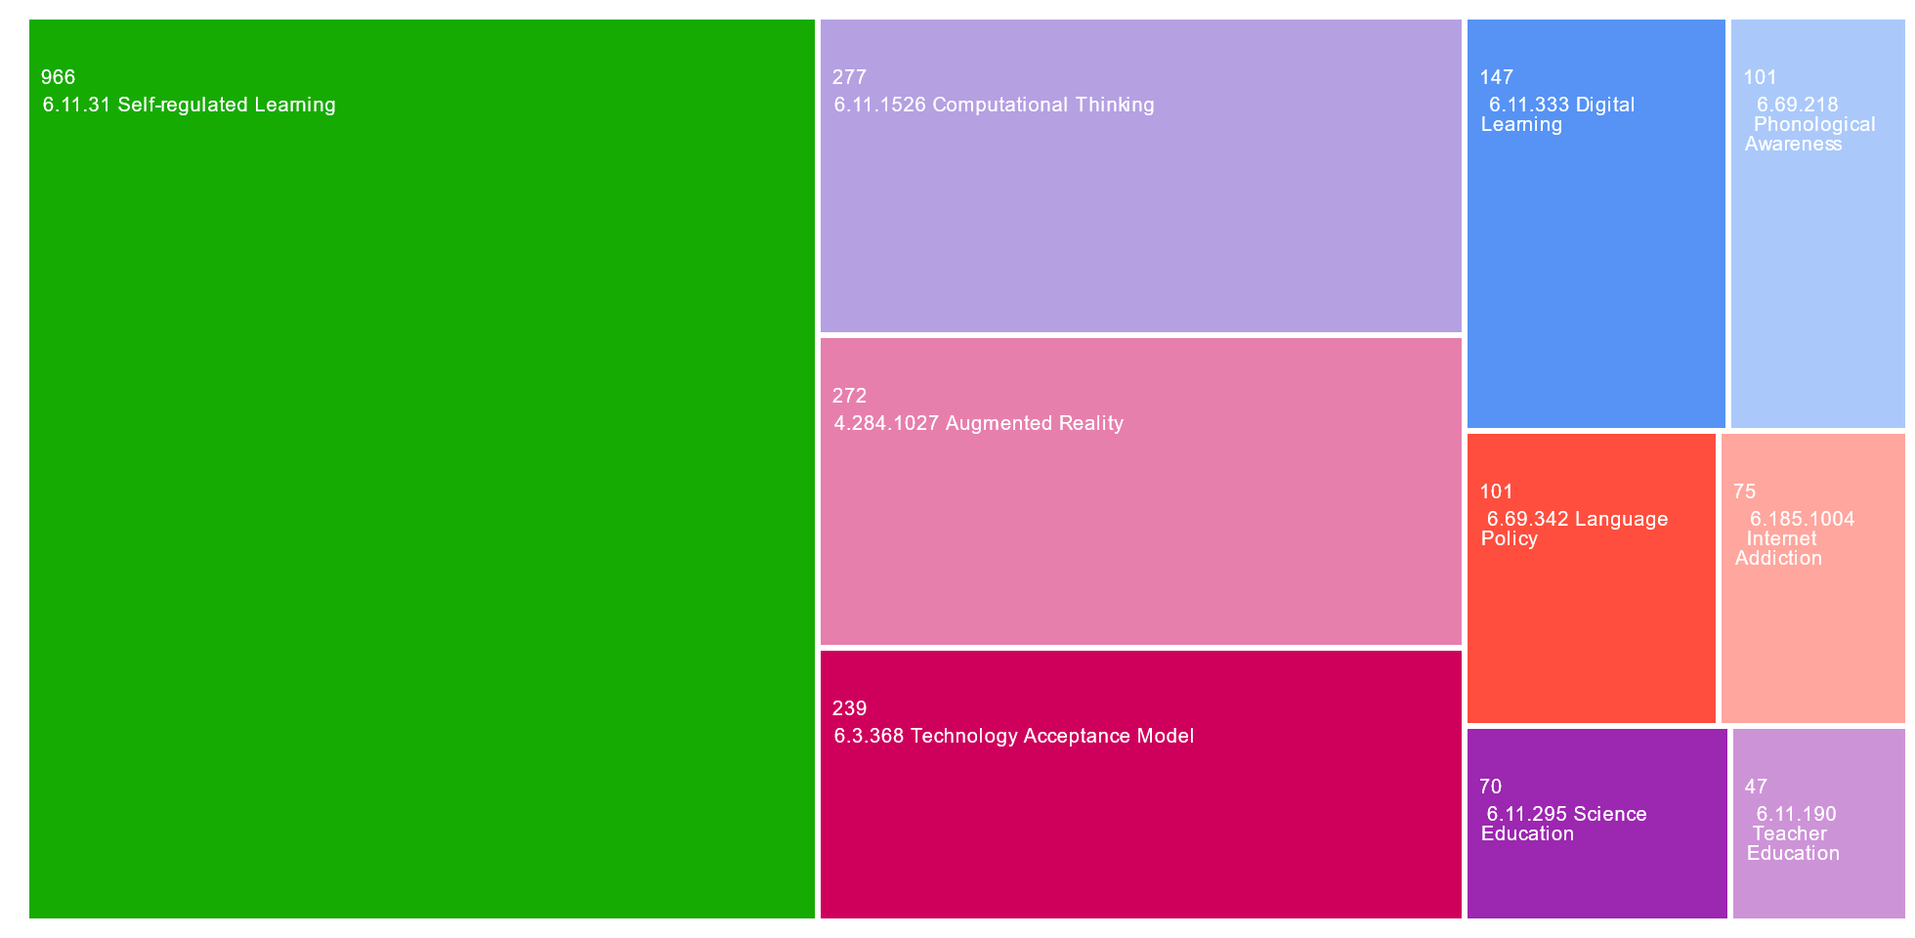
2020-2024 (3202 publications)

Slide 23
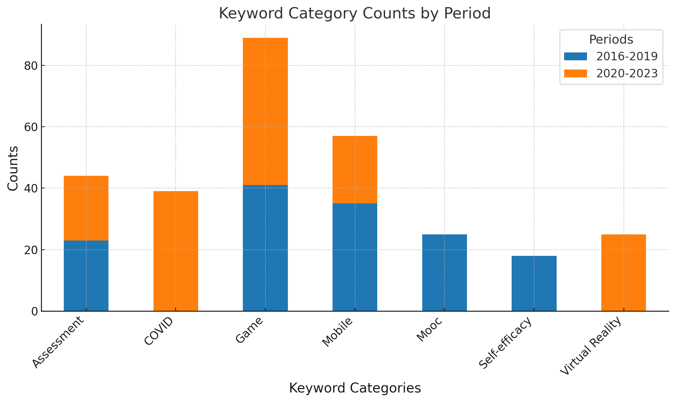

Slide 24
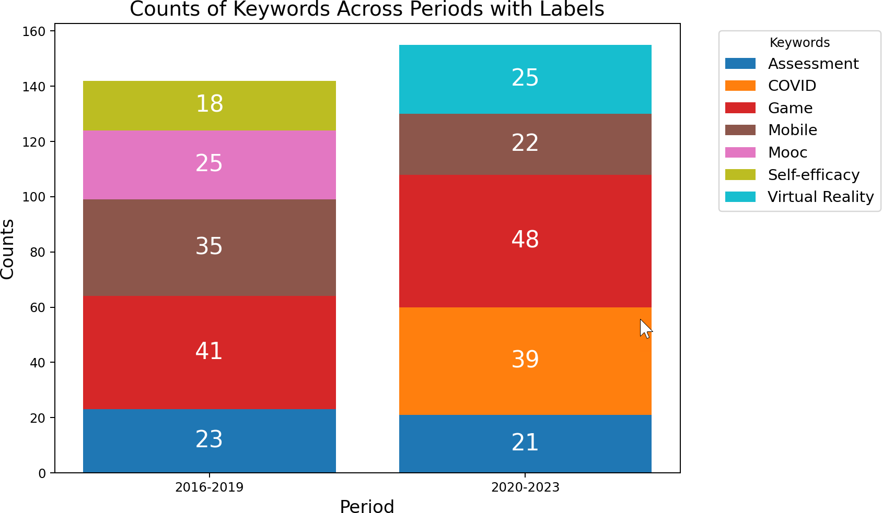

Slide 25
